Slide 1
OBE Implementation
Module-7:SCHOOLS
Team Name: E
Submitted By
M.RADHA KALYANI - AP22110010244
J.RAMYA REDDY- AP22110010209
M.DEEPTHI- AP2211001075
CSE | 6th Semester | 2022

Slide 2
Introduction to Project
As part of SRM University AP’s transition to Outcome Based Education(OBE),this module automates the management of schools(e.g, Engineering , Medicine, Humanities)within the university academic hiererchy.It replaces manual record-keeping with a secure,scalable digital system aligned with OBE standards.

Slide 3
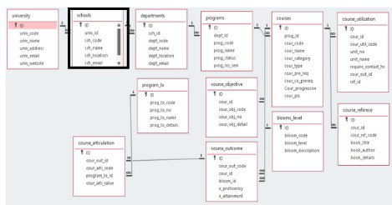
Architecture Diagram

Slide 4
Module Description : Courses Setting Module Description: Schools Management System Purpose The Schools Module is a core component of SRM-AP’s Outcome-Based Education (OBE) framework, designed to: Centralize all school-related data (e.g., Engineering, Medicine, Humanities) under the university hierarchy. Standardize school records for accreditation, reporting, and administrative processes. Facilitate seamless integration with other OBE modules (University, Departments, Courses).

Slide 5
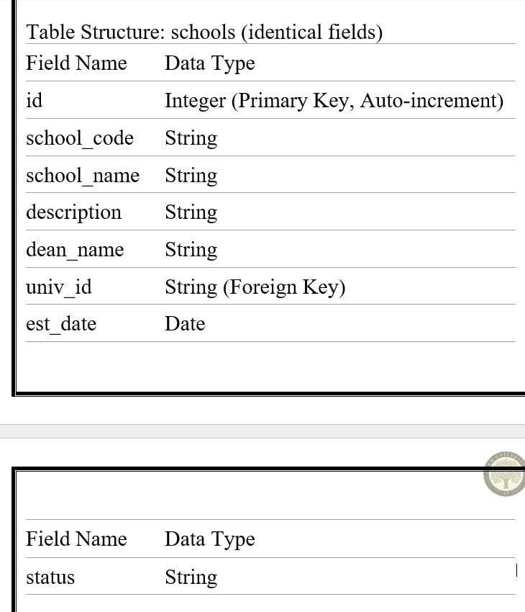
Courses Setting: Field/table details

Slide 6
Courses Setting:Programming Details
Class/Activity: schools_Schools
Functions:
Create: create.schools()
Update: update.schools()
Retrieve: retrieve.schools()
Delete: delete.schools()

Slide 7
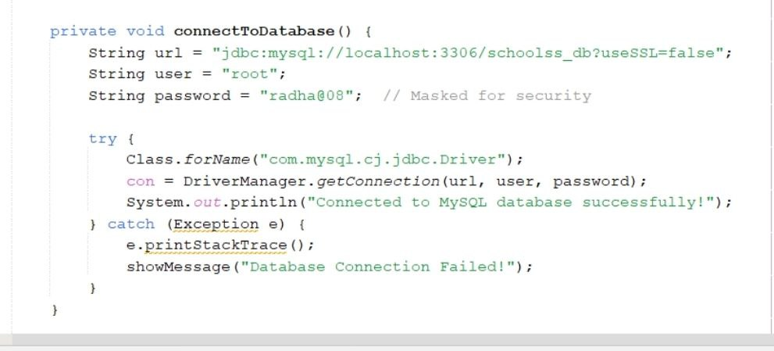
Sample Source Code
INSERT/ADD:

Slide 8
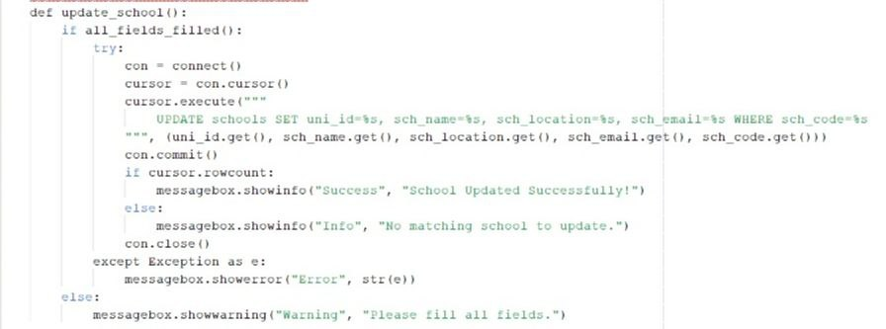
Sample Source Code
UPDATE:

Slide 9
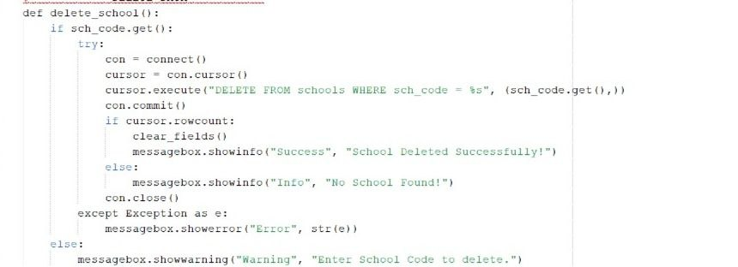
Sample Source Code
DELETE:

Slide 10
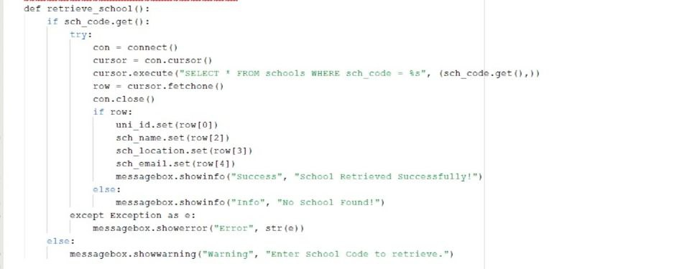
Sample Source Code
RETRIVE:

Slide 11
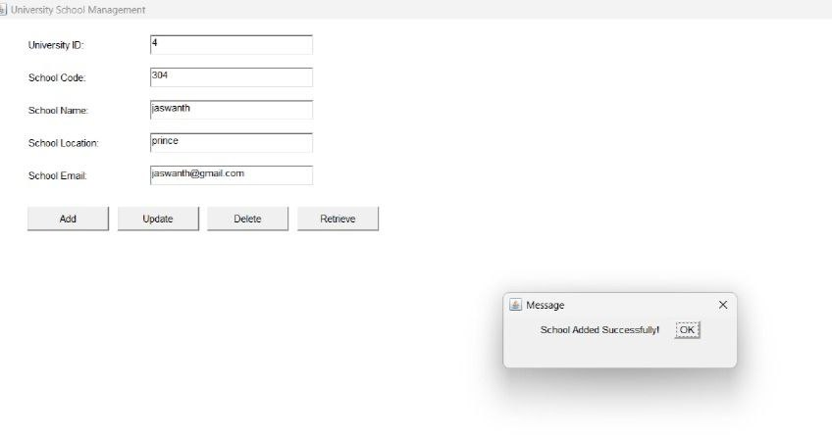
Sample Screen Shots

Slide 12
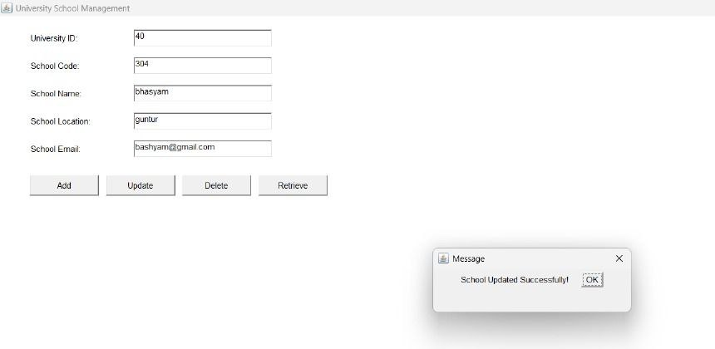
Sample Screen Shots

Slide 13
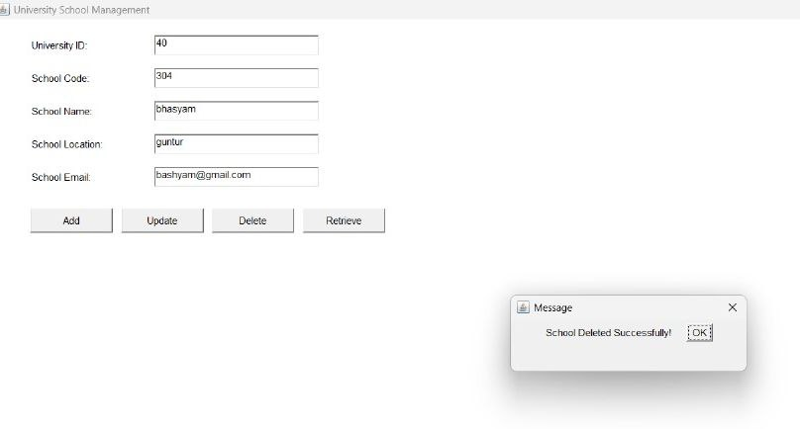
Sample Screen Shots

Slide 14
Conclusion
The Schools module plays an integral role in the OBE Implementation System at SRM-AP. It provides university administrators with the ability to manage core academic entities in a structured and secure way. By leveraging Java's capabilities for desktop application development and MySQL's robustness for data storage, the module ensures reliability, usability, and scalability.

Slide 15
Thank You

